Slide 1
Executive Presentation - Big Mountain Resort
Cole Romanyk

Slide 2
Problem Statement
By the start of the next ski season, through a data driven model determine:
The appropriate ticket price
What changes can drive revenues up?
Justify increasing ticket price
Cut current costs
Goal: increase revenue or cut costs in order to cover the $1,540,000.00 for the newest chairlift.
Notes:
Problem identification (1-2 slides)

Slide 3
Recommendation
Ticket price should be increased to $94.22
Current price only $81.00
Implement Scenario 2:
Add 1 chairlift
1 new run
Increase vertical drop by 150 ft.
Notes:
Recommendation and key findings (1 slide)

Slide 4
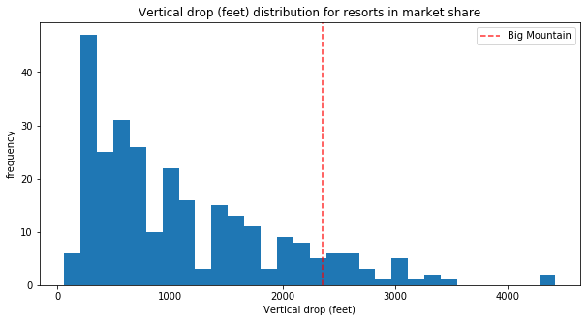
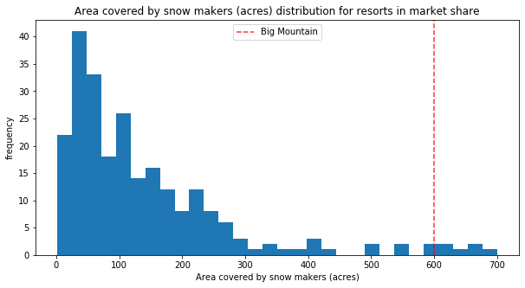
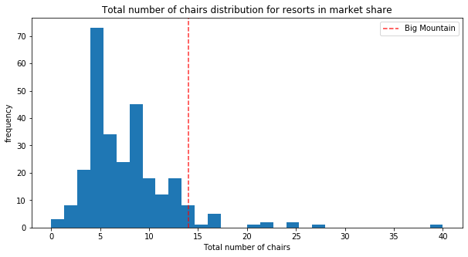
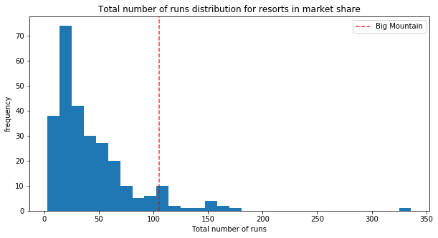
Analysis & Results
Big Mountain is an industry leader in ski resort features:
Notes:
Modeling results and analysis (3-4 slides)

Slide 5
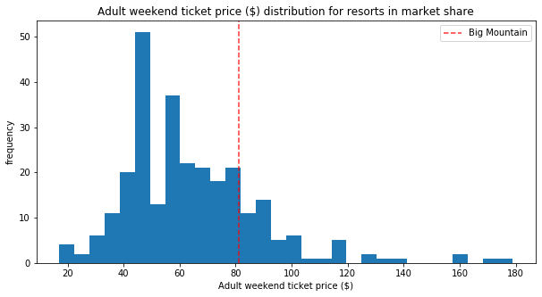
Analysis & Results
Current pricing strategy does not capture the value of those features
The model projects that given the resorts feature ticket price should be higher.
Projected price - $94.22
MAE - $10.39
Even at low end of error, projected price is still higher than $81.00

Slide 6
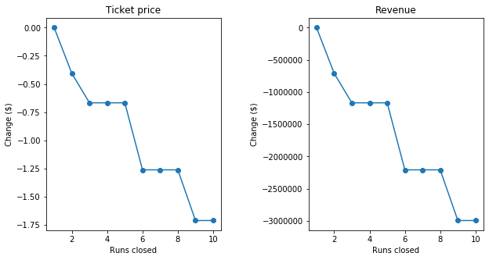
Analysis & Results – Cost Cutting
Scenario 1 – Reduce total run by 10
Negatives:
Reducing the runs drastically effect both ticket price and revenue
Silver Lining:
1 run may be closed at a time for maintenance or improvement without ticket price consequences

Slide 7
Analysis & Results - Improvements
Scenario 2 is the only scenario which can justify an increase in ticket price:
Ticket price increase of $8.46
Season revenue increase of $14,811,594.00
More than enough revenue to cover costs
Scenarios 3 & 4 do not provide enough change in features to justify increasing ticket price

Slide 8
Summary & Decision
Raise the current ticket price to $94.22, or at least to $85.40.
This will increase projected revenues by $32,977,000 and $29,890,000 respectively
$85.40 is the breakeven price to cover the costs of the newest chairlift
Pursue Scenario 2!
The revenue generated by the addition of these features will more than cover the costs associated with implementing it
Notes:
Summary and conclusion (1 slide)

